Slide 1


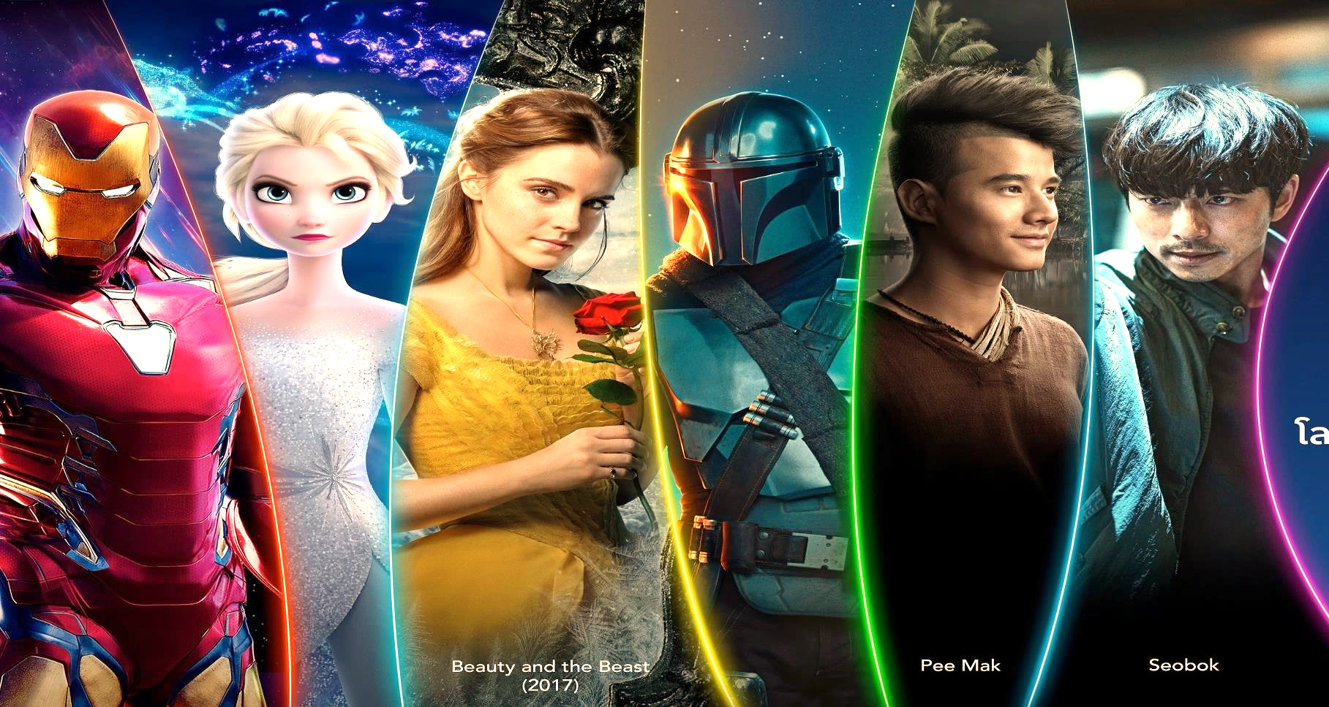
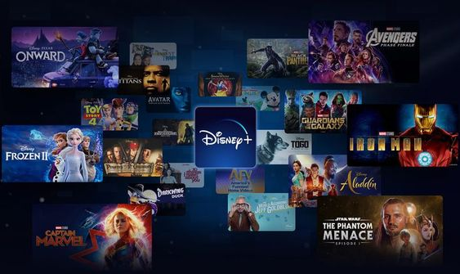
By
Yogeshbala B
MBE10
Disney+HotStar Data Analysis

Slide 2

Problem Statement
Provide an in-depth analysis and visualization of a movie dataset to uncover insights and trends. This includes understanding the distribution of movies by genre, running times, release years, age ratings, and other attributes

Slide 3





Business Use Cases:
Content Strategy
Streaming platforms can use the analysis to understand which genres are most popular and plan their content strategy accordingly.
Marketing Campaigns: Identifying trends in movie releases and popular genres can help in designing targeted marketing campaigns.
.
Historical Analysis:”sights into age ratings and running times can help platforms tailor their recommendations to different audience Segments.
Audience Segmentation: Insights into age ratings and running times can help platforms tailor their recommendations to different audience segments.

Slide 4
Business Use Cases:
Content Strategy
Streaming platforms can use the analysis to understand which genres are most popular and plan their content strategy accordingly.
Marketing Campaigns: Identifying trends in movie releases and popular genres can help in designing targeted marketing campaigns.
.
Historical Analysis:”sights into age ratings and running times can help platforms tailor their recommendations to different audience Segments.
Audience Segmentation: Insights into age ratings and running times can help platforms tailor their recommendations to different audience segments.

Slide 5
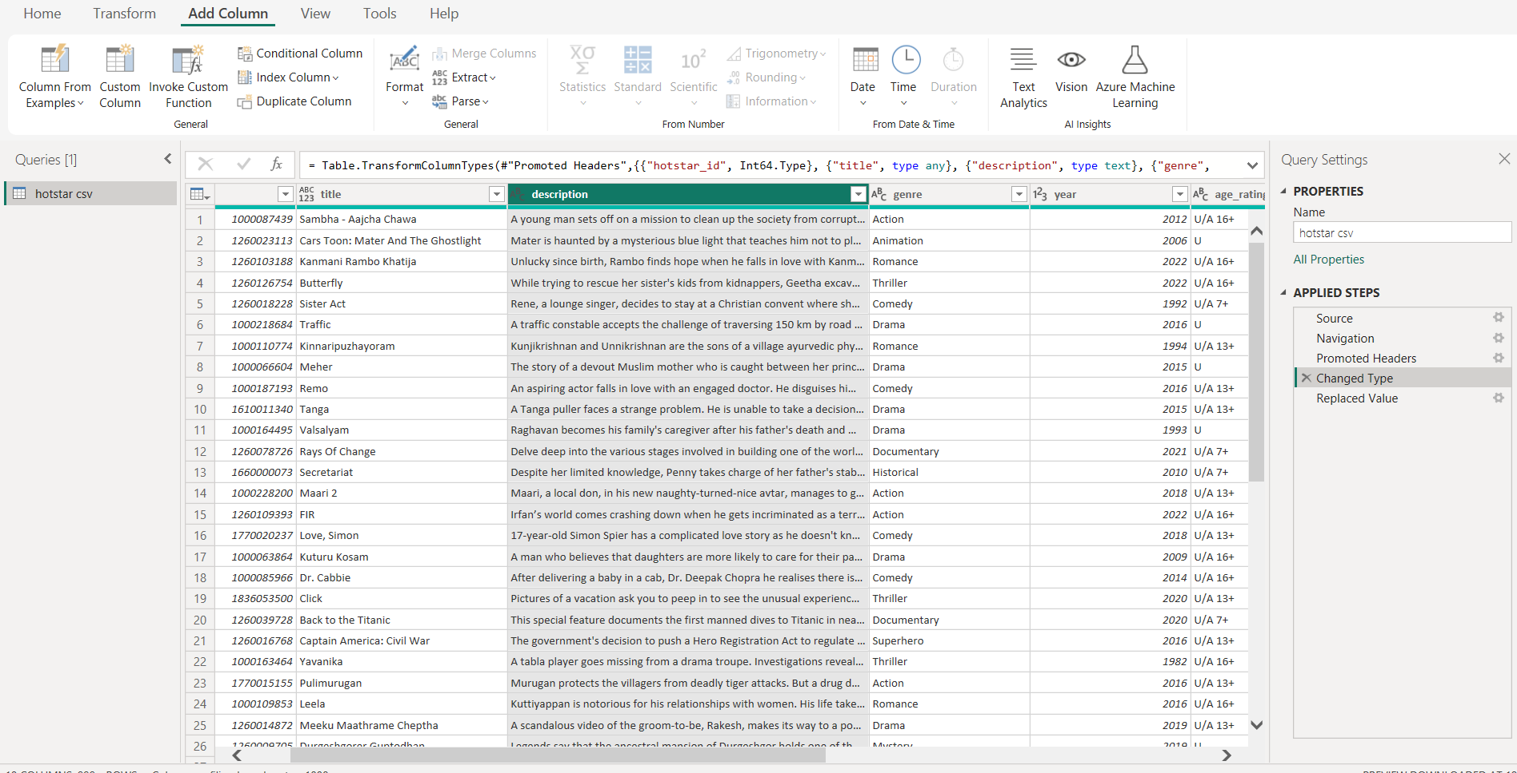
Data Processing With Power Query
Removed unwanted columns that are not necessary for analysis.
• Running time columns contain some null values and those values are filled with Average values.
Changed the formats for columns: Episodes and Seasons from text to int.
.

Slide 6

Tasks
Distribution of Movies by Genre
. Average Running Time by Genre
. Movies Released Each Year
. Top 10 Longest Movies
Movies by Age Rating
Count of Movies by Year and Genre
7. Most Common Movie Types Storytelling
8. Correlation Between Running
Time and Year
9. Genre Popularity Over Time
10. Movies by Genre and Age Rating
11. Movies with Maximum Episodes
12. Distribution of Running Time
.

Slide 7


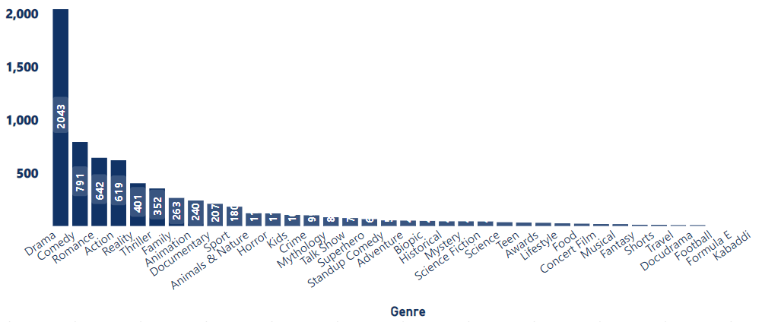
Distribution of Movies by Genre
Findings:
• The genre with the highest number of movies is "Drama," followed by "Comedy" and "Romance."
• Some genres like "Lifestyle" and "Food" have significantly less movies compared to others.
Insights:
• The higher count of Drama and Comedy movies suggests these genres are popular and frequently produced.
• The low count in specific genres might indicate niche markets or less audience interest
.
.

Slide 8
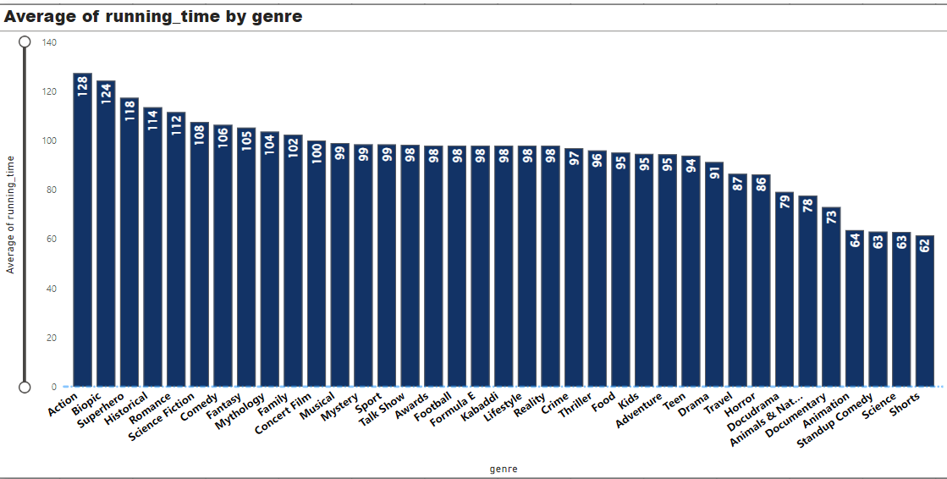
Average Running Time by Genre:
Findings:
Genres like "Action" and "Biopic" have higher average running times compared to genres like "Science" and "Standup Comedy.“
Insights:
• Action and Biopic often require more screen time to cover detailed information and narratives, leading to longer average running times.
• Shorter running times in genres like Science and Standup Comedy may cater to the preferences of their target audiences
.
.

Slide 9
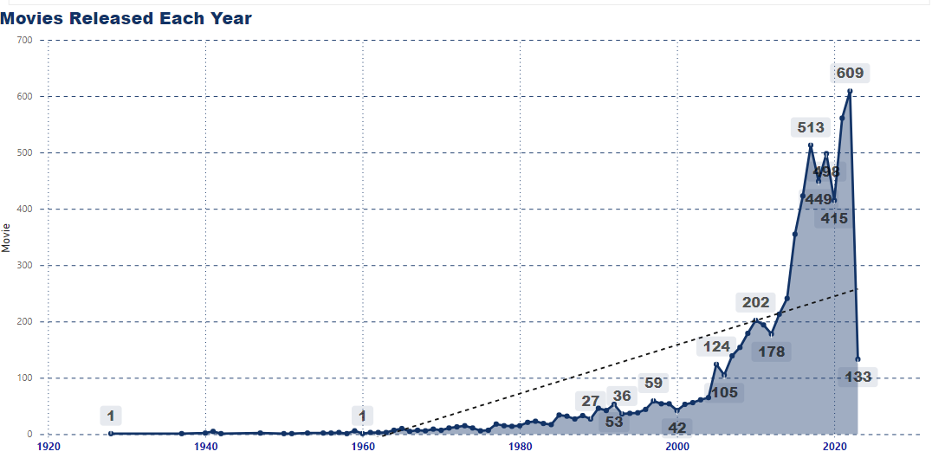
Movies Released Each Year:
Findings:
• The number of movies released annually has shown a flat line from 1963 to 2000, and there is a noticeable peaks after 2000.
Steady Rise: Movie releases climbed steadily through the 2010s, reaching 561 in 2021.
Big Increases: There were major jumps in the number of films, especially in 2015 (355), 2016 (423), and 2017 (513).
Insights:
• The increase in movie releases could be due to technological advancements, changes in consumer demand, and growth in the entertainment industry.
• Peaks in specific years might be linked to significant industry events or trends.
.
.

Slide 10
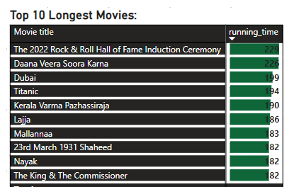
Top 10 Longest Movies:
Findings:
• The longest movie in the dataset is "The 2022 Rock & Roll Hall of Fame Induction Ceremony" with a running time of 229 minutes.
Insights:
• Long movies often have complex plots or extensive narratives requiring extended screen time.
• The top 10 longest movies are primarily from genres like "Drama" and "Action."
.
.

Slide 11

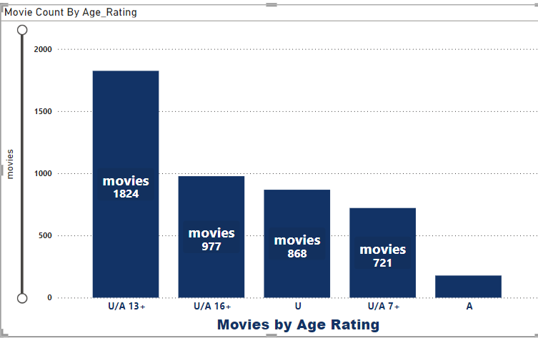
Movies by Age Rating
Findings:
• All the movies are fall under equal proportion of ratings.
• From this, “U/13+” is top with 1823 Movies .
Insights:
Majority Focus: 39% of movies are suitable for ages 13+, indicating a strong market for teen content.
Family-Friendly Content: 34% aimed at younger audiences (U & U/A 7+), reflecting a demand for family-oriented films.
Niche Market: Only 3.8% rated A (Adult), suggesting limited production in this category.
Opportunities: Potential for diverse genres in U/A 13+ films to engage younger audiences further.
.
.
.

Slide 12
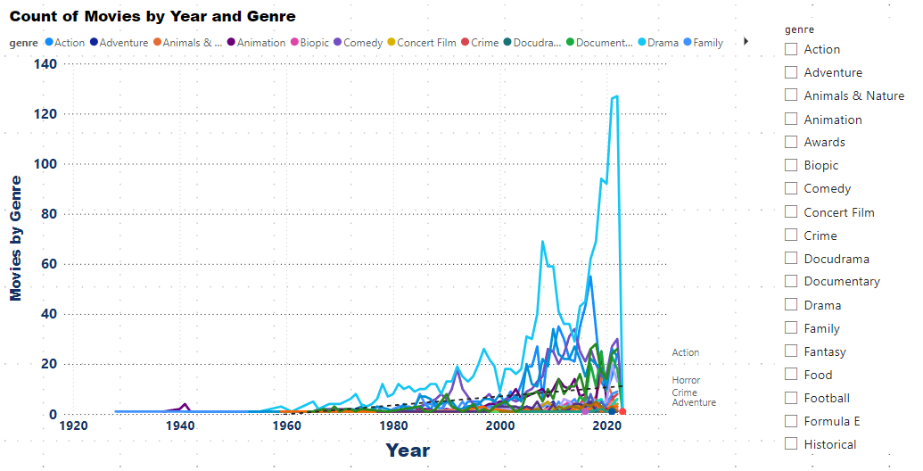
Genre Popularity Over Time
Findings And Insights
Dominance of Drama: Remains the most popular genre, peaking at 127 movies in 2022.
Rising Action and Comedy:
Action shows growth, particularly in 2018 and 2022.
Comedy maintains a strong presence, with 30 movies in 2022.
Emergence of Thrillers and Documentaries: Increased popularity, especially from 2018 onwards.
Shifting Preferences: Traditional genres like Romance and Animation are declining, indicating changing viewer interests.
.
.

Slide 13
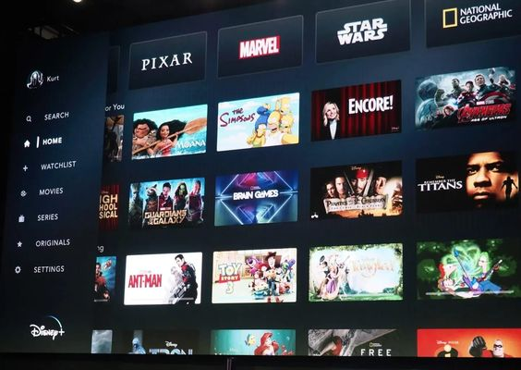
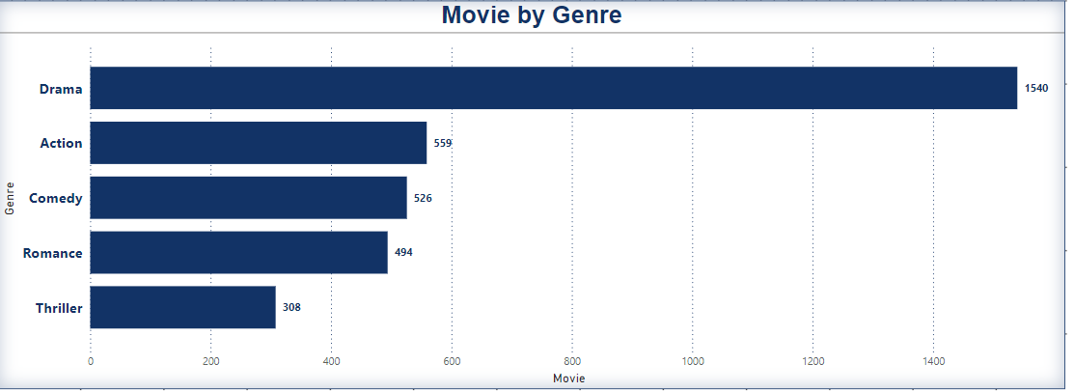
Most Common Movie Types
Findings:
• The majority of the dataset consists of Drama, followed by Comedy.
Insights:
• The dominance of Drama indicates this format are the most produced.
• Less common types might cater to specific audience segments or serve niche markets
.
.

Slide 14
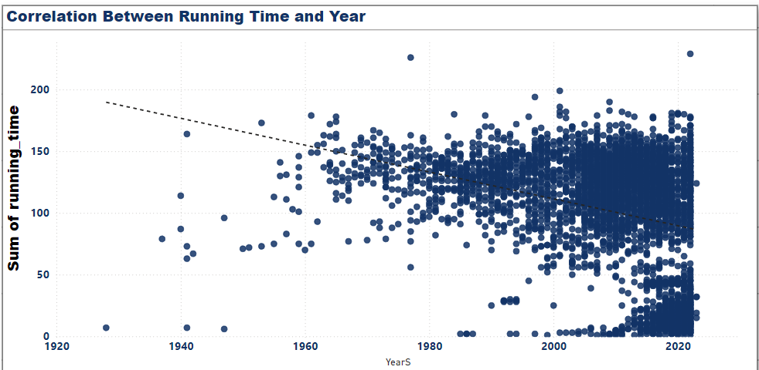
Correlation Between Running Time and Year
Findings:
• Over the years, the running time of movies are gradually decreased.
Insights:
• Nowadays people don’t have the patience to watch longer running-time movies
. • So slight decrease in running time in recent years that might reflect changes in production styles or audience preferences.
.
.

Slide 15
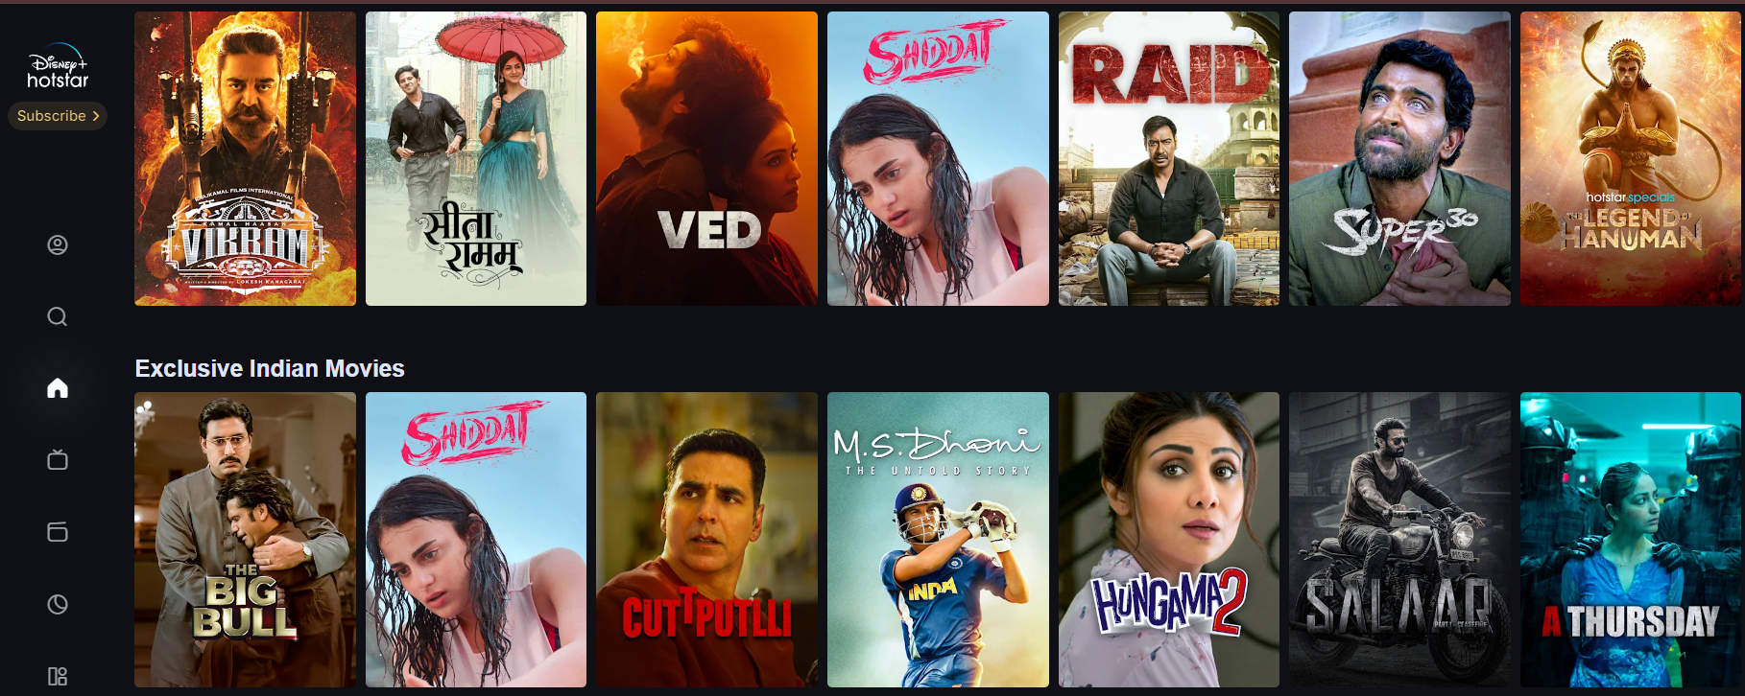
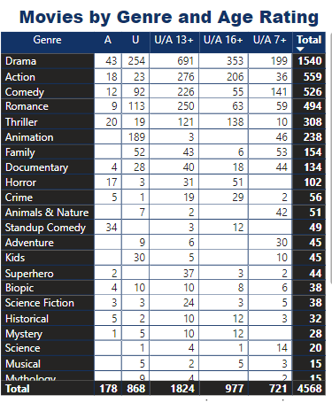
Movies by Genre and Age Rating:
Movies by Genre and Age Rating:
Insights
Most Common Genre: Drama (1,317 films) – Highlights audience preference for emotional narratives.
Leading Age Rating: U/A 13+ (1,125 films) – Indicates a focus on family-friendly content appealing to teens and young adults.
Significant Genres:
Action (U/A 13+ & U/A 16+): 276 & 206 films, respectively.
Romance (U/A 13+ & U): 250 & 113 films, indicating strong appeal across age groups.
Underrepresented Higher Ratings: Fewer entries in genres like Horror and Science Fiction for adult ratings, suggesting potential growth areas.
Market Opportunity: Consider expanding content for older audiences while maintaining success in U/A 13+ films.
.
.
.

Slide 16
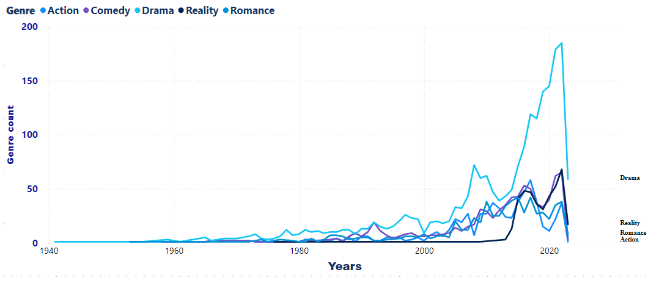
Genre Popularity Over Time
Findings:
• Genre like "Drama" have seen consistent popularity, with noticeable peaks from 2007 to now
. • Some genres, such as "Romance" and "Action", have shown significant growth over time.
Insights:
• The consistent popularity of certain genres indicates stable audience interest.
• The growth in specific genres might be driven by trends, technological advancements, or changes in audience preferences
.
.

Slide 17
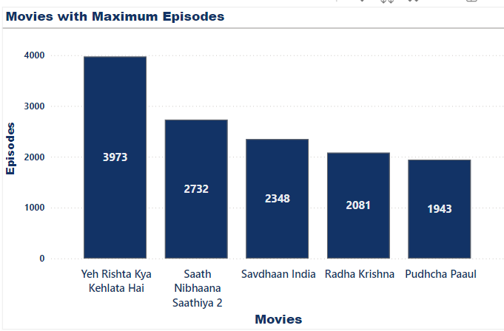
Movies with Maximum Episodes:
Findings:
• The movie with the highest number of episodes is "Yeh Rishta Kya Kehlata Hai" with 3973 episodes.
Insights:
• Tv shows with multiple episodes are likely part of series or anthologies, offering extended content to the audience.
• These TV shows may attract viewers who prefer longer, serialized content.
.
.

Slide 18

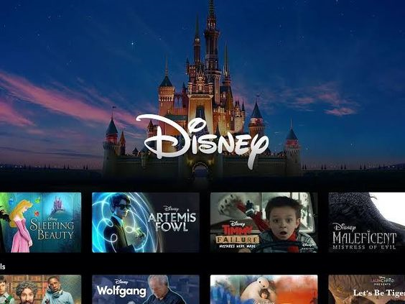
Result
1. Popular Genres: Drama, Comedy, and Romance are the most prevalent genres, indicating a strong audience preference and frequent production.
2. Running Time: Action and Biopic movies tend to have longer running-times, reflecting the need for more screen time to develop complex narratives.
3.Release Trends: The number of movies released annually post-2000 has increased noticeably, likely due to technological advancements and increased demand.
4. Age Ratings: A significant portion of movies are rated “U/13+”, suggesting a focus on broad audience appeal, while less movies are rated ‘A’, which may limit viewership to mature audiences.
5. Series and Anthologies: Shows with a high number of episodes, such as "Yeh Rishta Kya Kehlata Hai", indicate a successful strategy in serialized content that keeps viewers engaged over long periods
.
.

Slide 19
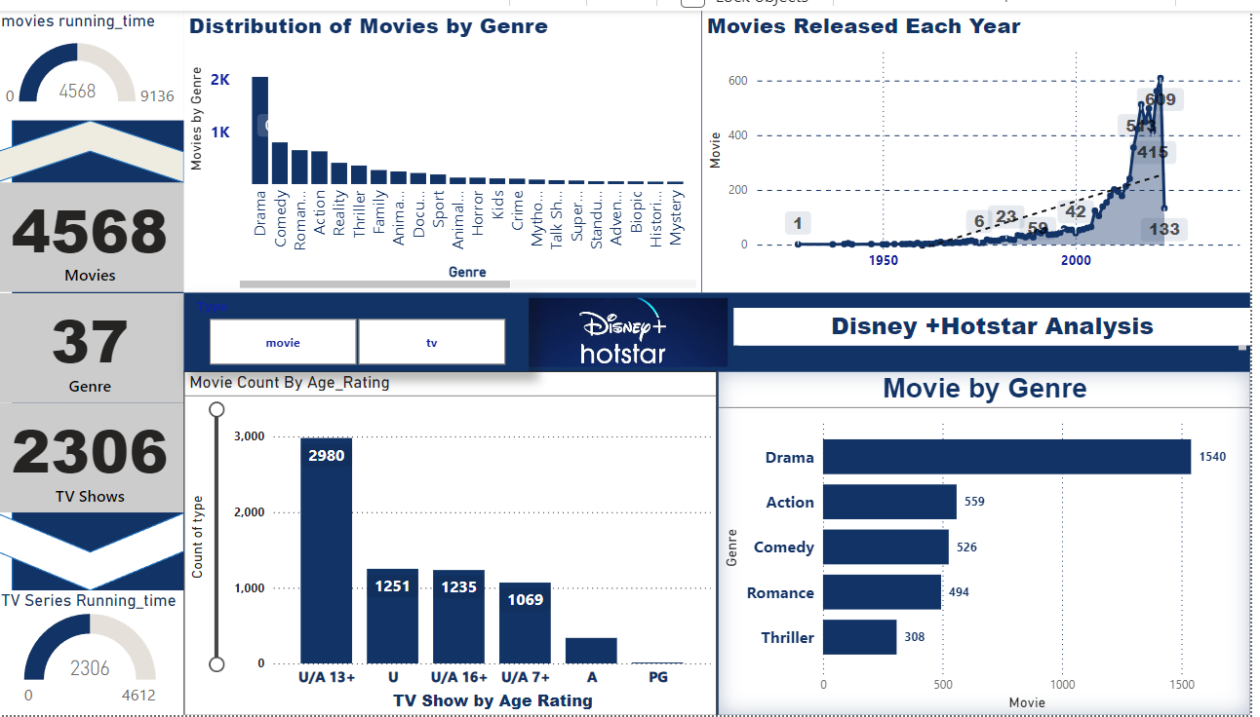
DISNEY + HOTSTAR ANALYSIS DASHBOARD
content opportunities.
.
.

Slide 20
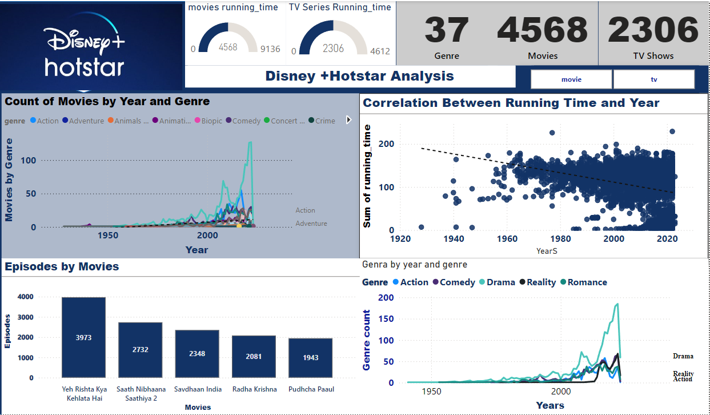
DISNEY + HOTSTAR ANALYSIS DASHBOARD
content opportunities.
.
.

Slide 21
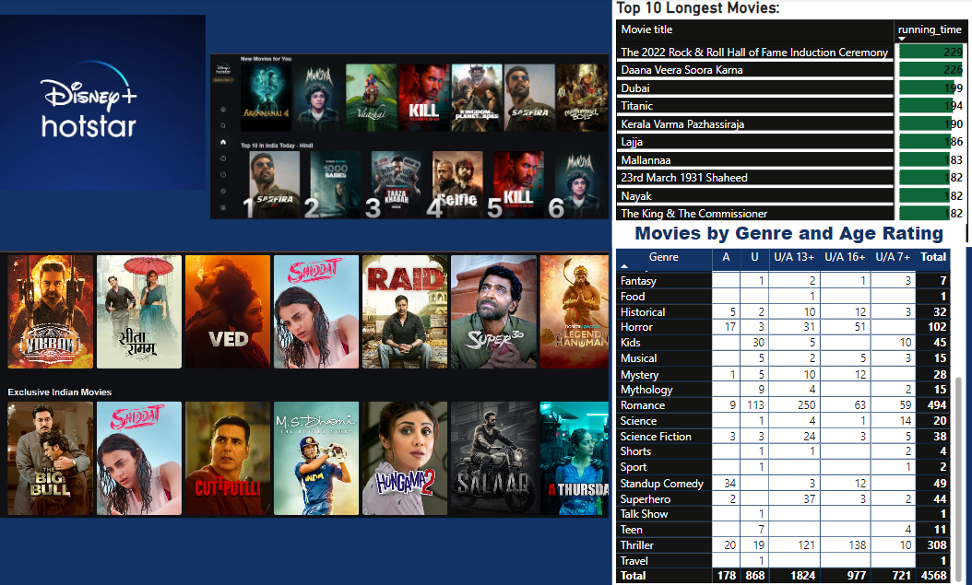
content opportunities.
.
.

Slide 22
Conclusion
The results underscore the platform's strategic emphasis on widely appealing genres, showcasing its intent to capture a broad audience. However, there are clear avenues for expansion into less mainstream genres and innovative content formats. To sustain and enhance viewership, future content strategies should balance the focus on popular genres with an exploration of niche markets and serialized content opportunities.
.
.

